Slide 1
Online Animal Care Software Engineering [E] Group - 3

Slide 2
System Actors
User
Veterinarian
Shop
Rescue Center

Slide 3
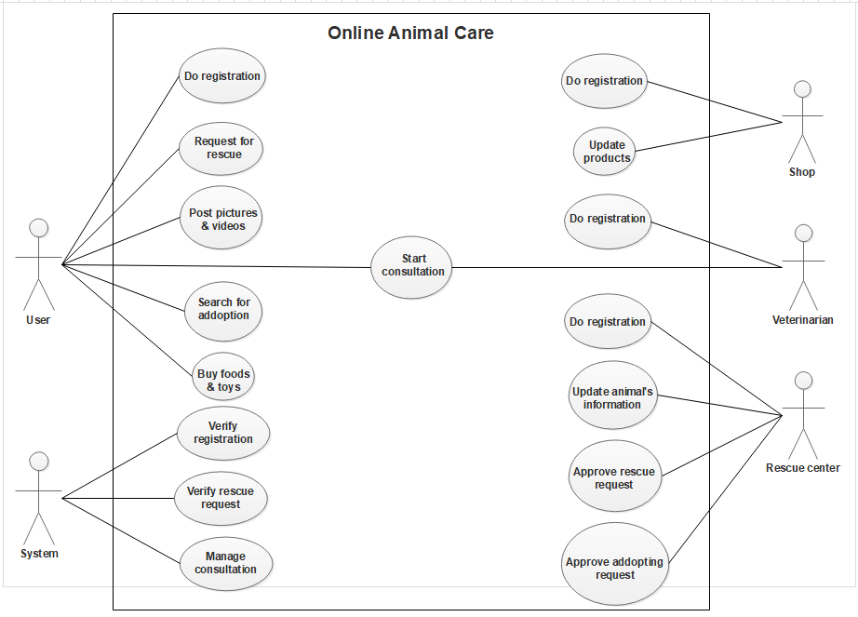
Use Case diagram

Slide 4
Thank You

